Slide 1

CENTRAL PROCESSING UNIT
FALL 2021
CSE102L Computer programming Lab
LAB #04
Muhammad Umar Jan
ETEA ID : 1508
Submitted To : Prof Eng Abdullah Hamid

Slide 2
CENTRAL PROCESSING UNIT
The computer's central processing unit (CPU) is the portion of a computer that retrieves and executes instructions.
The CPU is essentially the brain of a CAD system.
It consist of an arithmetic and logic unit (ALU), a control unit, and various registers.
This contrasts with external components such as main memory and I/O circuitry, and specialized processors such as graphics processing units (GPUs).
CPU performs all types of data processing operations.
The CPU is called the brain of the computer.

Slide 3
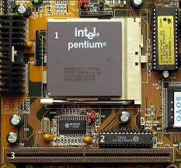
CENTRAL PROCESSING UNIT
A central processing unit (CPU), also called a central processor, main processor or just processor, is the electronic circuitry that executes instructions.
Central Processing Unit

Slide 4
